Slide 1
Most important programming guideline:
Make interfaces easy to use correctly and hard to use incorrectly,
but achieving it can be challenging.
- Scott Meyers -
Author, Consultant & C++ Guru

Slide 2
Who Am I and What Am I Doing Here?
C++ Evangalist
Template Meta Programming Nerd
Embedded Developer
Kvasir.io / brigand / SG14 contributor
Part of an awesome development team!
Contract developer / Consultant

Slide 3
Embedded C++ Paradigms
Saving the World, One Bit-Trick at a Time

Slide 4
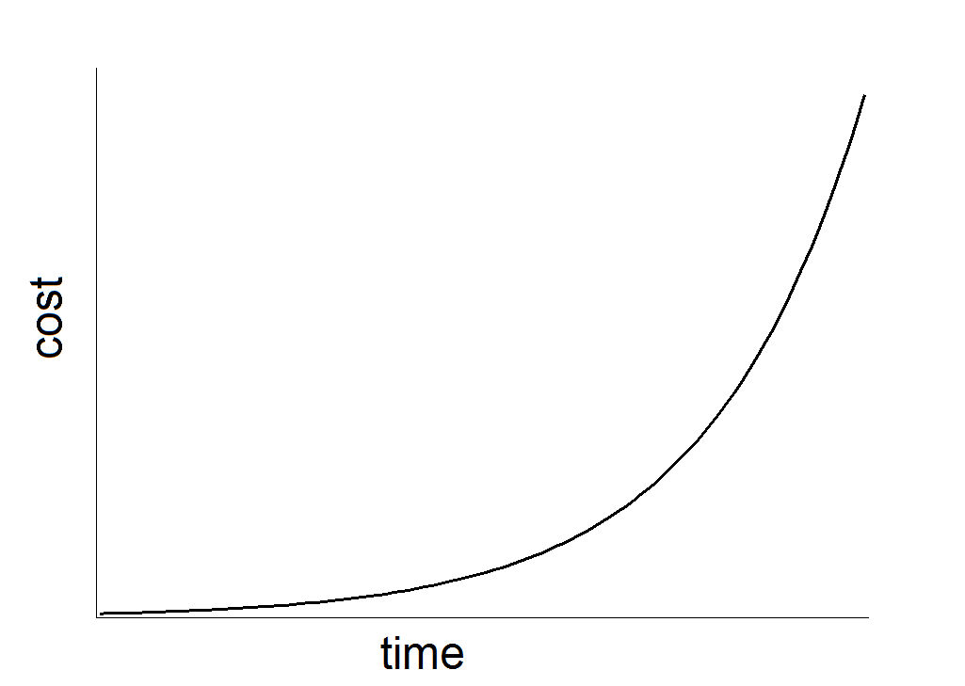
DIN 55350

Slide 5
Code Review
//deep in some headder
#define LPUART_C_ADDR_REG *(volatile unsigned*) 0x40011004
#define LPUART_C_STAT_REG *(volatile unsigned*) 0x4001100C
//somewhere else in some headder
#define C_ADDRESS_MASK 0x1F000000
#define C_ADDRESS_OFFSET 16
#define C_RX_FLAG_MASK (1<<7)
void f(){
//...
static int* stack = (int*)malloc(sizeof(int)*100);
stack[top++] = LPUART_C_ADDR_REG & C_ADDRESS_MASK >> C_ADDRESS_OFFSET;
LPUART_C_STAT_REG |= C_RX_FLAG_MASK;
//...
}

Slide 6
Code Review
//deep in some headder
#define LPUART_C_ADDR_REG *(volatile unsigned*) 0x40011004
#define LPUART_C_STAT_REG *(volatile unsigned*) 0x4001100C
//somewhere else in some headder
#define C_ADDRESS_MASK 0x1F000000
#define C_ADDRESS_OFFSET 16
#define C_RX_FLAG_MASK (1<<7)
void f(){
//...
static int* stack = (int*)malloc(sizeof(int)*100);
stack[top++] = LPUART_C_ADDR_REG & C_ADDRESS_MASK >> C_ADDRESS_OFFSET;
LPUART_C_STAT_REG |= C_RX_FLAG_MASK;
//...
}

Slide 7
Where Bugs Are Born:
Volatile
See John Regehr, University of Utah for good papers and blogs

Slide 8
Reordering Rules
constexpr int BUF_SIZE = 40;
volatile int buffer_ready;
char buffer[BUF_SIZE];
void buffer_init() {
int i;
for (i = 0; i<BUF_SIZE; i++)
buffer[i] = 0;
buffer_ready = 1;
}
Notes:
Nvic in a headder

Slide 9
Reordering Rules with ISRs
//in a headder file, unmodified CMSIS implementation
__STATIC_INLINE void NVIC_DisableIRQ(IRQn_Type IRQn)
{
NVIC->ICER[0] = (uint32_t)(1UL << (((uint32_t)(int32_t)IRQn) & 0x1FUL));
}
__STATIC_INLINE void NVIC_EnableIRQ(IRQn_Type IRQn)
{
NVIC->ISER[0] = (uint32_t)(1UL << (((uint32_t)(int32_t)IRQn) & 0x1FUL));
}
int my_flag;
void f(){
//in user code
NVIC_DisableIRQ(USB0_IRQn);
my_flag++;
NVIC_EnableIRQ(USB0_IRQn);
}
void g(){ my_flag--; } //in USB ISR

Slide 10
Reordering Rules with ISRs
//in a headder file, unmodified CMSIS implementation
__STATIC_INLINE void NVIC_DisableIRQ(IRQn_Type IRQn)
{
NVIC->ICER[0] = (uint32_t)(1UL << (((uint32_t)(int32_t)IRQn) & 0x1FUL));
}
__STATIC_INLINE void NVIC_EnableIRQ(IRQn_Type IRQn)
{
NVIC->ISER[0] = (uint32_t)(1UL << (((uint32_t)(int32_t)IRQn) & 0x1FUL));
}
volitile int my_flag;
void f(){
//in user code
NVIC_DisableIRQ(USB0_IRQn);
my_flag++;
NVIC_EnableIRQ(USB0_IRQn);
}
void g(){ my_flag--; } //in USB ISR

Slide 11
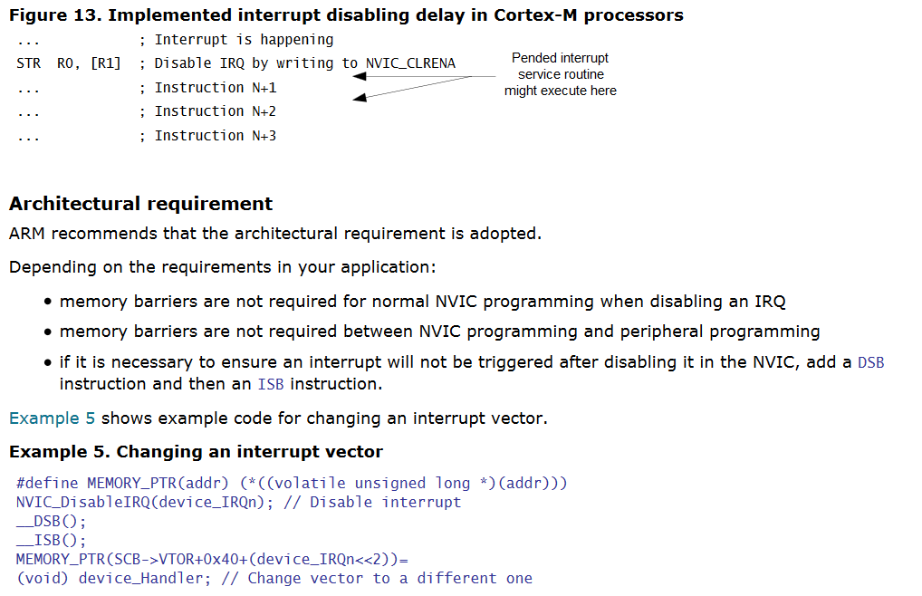
Hardware Sequential Consistancy

Slide 12
Reordering Rules: Global Interrupt Disable
volatile int my_flag;
asm ("cpsie i");
my_flag = 1
asm ("cpsid i");
asm volatile ("cpsie i");
my_flag = 1
asm volatile ("cpsid i");
asm volatile ("cpsie i:::");
my_flag = 1
asm volatile ("cpsid i:::");

Slide 13
Real World Reordering Rules
struct USBHAL{
//definition of epCallback
bool(USBHAL::*epCallback[8 - 2])(void);
USBHAL(){
NVIC_DisableIRQ(USB0_IRQn);
// fill in callback array
epCallback[0] = &USBHAL::EP1_OUT_callback;
epCallback[1] = &USBHAL::EP1_IN_callback;
epCallback[2] = &USBHAL::EP2_OUT_callback;
epCallback[3] = &USBHAL::EP2_IN_callback;
epCallback[4] = &USBHAL::EP3_OUT_callback;
epCallback[5] = &USBHAL::EP3_IN_callback;
NVIC_EnableIRQ(USB0_IRQn);
//...
}
}
Notes:
Only pick on mbed because its open source and from ARM

Slide 14
Code Review
//deep in some headder
#define LPUART_C_ADDR_REG *(volatile unsigned*) 0x40011004
#define LPUART_C_STAT_REG *(volatile unsigned*) 0x4001100C
//somewhere else in some headder
#define C_ADDRESS_MASK 0x1F000000
#define C_ADDRESS_OFFSET 16
#define C_RX_FLAG_MASK (1<<7)
void f(){
//...
static int* stack = (int*)malloc(sizeof(int)*100);
stack[top++] = LPUART_C_ADDR_REG & C_ADDRESS_MASK >> C_ADDRESS_OFFSET;
LPUART_C_STAT_REG |= C_RX_FLAG_MASK;
//...
}

Slide 15
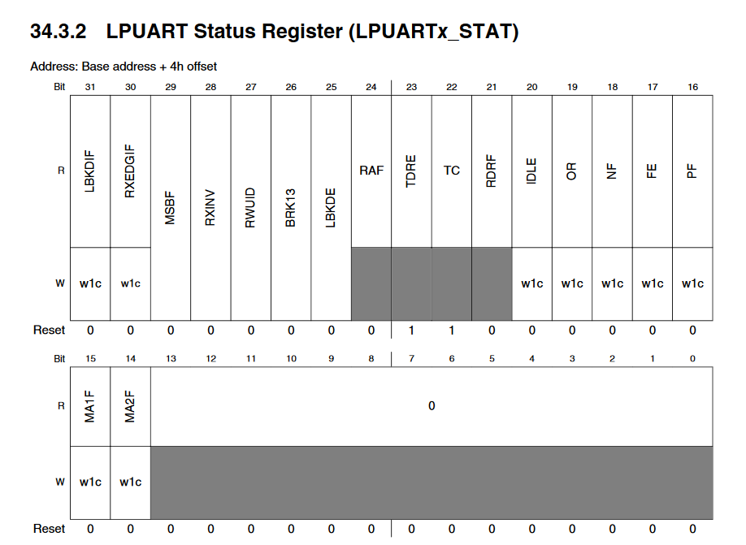
Bit Fields

Slide 16
#BitfieldProblems
Mask-register applicability errors
Special register functionality:
Clear on read
Set to clear
Reserved bits
FIFO
Field offset errors
Optimization (volatile problems)
ISR collisions
Notes:
Cmsis svd -> C loss of information

Slide 17
Mental Model of Registers
address
Ignore Write 1
Ignore Write 0
Special Action
Address
Field Location
Field Value
Action
value
read
write
XOR
write Literal
mask
FieldType
enum
int
bool
Access
read only
write only

Slide 18
constexpr Type-Encoded Tag
template<typename Location, typename Action, int Value>
struct Action{};
template<unsigned Address, unsigned Mask, typename TType = int /* … */>
struct FieldLocation{
using DataType = TType;
};
constexpr FieldLocation<0x1234, (1 << 4)> myBits{};

Slide 19
constexpr Metafunction
//turn a bit location into an action which sets the corresponding bit
template<typename T>
constexpr Action<T, WriteTag, 1> set(T) {
return{};
}
template<typename T>
constexpr typename MakeClearAction<T, WriteTag, 1>::type clear(T) {
return{};
}
template<typename... T>
void apply(T...) {/*lazy magic*/ }

Slide 20
User Code Example
//user code
apply(set(Uart1::cfgEnable));
apply(write(Uart1::cfgStopBValC::one, Uart1::cfgDataBValC::nine));
if(apply(read(cfgEnable))) == true){}
auto temp = apply(read(Uart1::cfgStopB, Uart1::cfgDataB, Uart1::prescale));
if(temp == Uart1::cfgDataBValC::nine){}
else if(temp[Uart1::prescale] == 100){}
//or C++17
const auto[s,d,p] = apply(read(Uart1::cfgStopB, Uart1::cfgDataB,
Uart1::prescale));
if (d == Uart1::cfgDataBValC::nine) {}
else if (p == 100) {}

Slide 21
Real World Library Code
namespace Usb0Istat{ ///<Interrupt Status register
using Addr = Register::Address<
0x40072080, //address
0xff, //bits where writes of 0 are ignored
0x00, //bits where writes of 1 are ignored
unsigned char //type of register
>;
///no description available
constexpr Register::FieldLocation<Addr,Register::maskFromRange(0,0),
Register::Access<
Register::AccessType::readWrite,
Register::ReadActionType::normal,
Register::ModifiedWriteValueType::oneToClear>,
bool> usbrst{};
///no description available
//...
}
Notes:
Shit in shit out

Slide 22
Real World Library Code 2
namespace Usb0Inten{ ///<Interrupt Enable register
using Addr = Register::Address<0x40072084,0x40,0x00,unsigned char>;
///USBRST Interrupt Enable
enum class UsbrstenVal {
v0=0x00000000, ///<Disables the USBRST interrupt.
v1=0x00000001, ///<Enables the USBRST interrupt.
};
constexpr Register::FieldLocation<Addr,Register::maskFromRange(0,0),
Register::ReadWriteAccess,UsbrstenVal> usbrsten{};
namespace UsbrstenValC{
constexpr Register::FieldValue<decltype(usbrsten)::Type,UsbrstenVal::v0> v0{};
constexpr Register::FieldValue<decltype(usbrsten)::Type,UsbrstenVal::v1> v1{};
}
}

Slide 23
Extention File Enum Correction
".PORTA" : {
"register" : {
"PCR0" : {
"field" : {
"MUX" : {
"enum" : {
"000" : {".rename" : "disabled"},
"001" : {".rename" : "gpio" },
"010" : {".rename" : "reserved"},
"011" : {".rename" : "tpm0ch5"},
"100" : {".rename" : "reserved"},
"101" : {".rename" : "reserved"},
"110" : {".rename" : "reserved"},
"111" : {".rename" : "swdClk"}
}
}
}
}
}
}

Slide 24
Extention File Enum Correction
"kvasir" : {
"io" : {
"default" : { "type" : "group", "ports" : "A-E",
"peripheral" : "GPIO%s"},
"output" : {"value" : 1, "register" : "PDDR"},
"input" : {"value" : 0, "register" : "PDDR"},
"set" : {"value" : 1, "register" : "PSOR"},
"clear" : {"value" : 1,"register" : "PCOR"},
"toggle" : {"value" : 1,"register" : "PTOR"},
"read" : {"register" : "PDIR"}
}
}

Slide 25
GPIO in Kvasir
namespace Io = Kvasir::Io;
// **** pin locations for FRDM-KL27Z board ****
constexpr auto ledr = makePinLocation(Io::portB, Io::pin18);
constexpr auto ledb = makePinLocation(Io::portA, Io::pin13);
constexpr auto ledg = makePinLocation(Io::portB, Io::pin19);
constexpr auto adc_input = makePinLocation(Io::portB, Io::pin2);
// **** pure laziness ****
namespace k = Kvasir;
constexpr auto pinAssignment = list(makeOutput(ledr, ledb, ledg),
makeInput(adc_input),
write(k::PortaPcr13::MuxValC::gpio,
k::PortbPcr18::MuxValC::gpio,
k::PortbPcr19::MuxValC::gpio,
k::PortbPcr2::MuxValC::adc0Se12,
k::PortbPcr3::MuxValC::gpio));
apply(pinAssignment/*probably other lists of init stuff here*/);

Slide 26
New Pin Definition Syntax
namespace Io = Kvasir::Io::port;
// **** pin locations for FRDM-KL27Z board ****
constexpr auto ledr = Io::B,18_c;
constexpr auto ledr = Io::B[18_c];
constexpr auto ledb = 0xA’13_pin;
constexpr auto ledg = 2.19_pin;
constexpr auto adc_input = Io::B::pin2;

Slide 27
Port Manipulation in Kvasir
constexpr auto lcdPort = makePort(
1.1_pin, 1.2_pin, 1.3_pin, 1.4_pin, 1.5_pin,
1.6_pin, 1.9_pin, 1.10_pin);
apply(write(lcdPort, 10));
apply(write(lcdPort, 10_c));
struct PrintToLcdFinished {};
auto myLcd = LCD::make(myQueue, lcdPort, LCD::rst = 2.7_pin,
LCD::rw = 2.8_pin, LCD::onWritten<PrintToLcdFinished>);
myLcd.put('c');

Slide 28
Port Manipulation 2
struct PrintToLcdFinished {};
auto queue = Queue::make(
list(PrintToLcdFinished{},LCD::onTimerEvent),
time::make(time::hw = timer0));
auto myLcd = LCD::make(myQueue, lcdPort, LCD::rst = 2.7_pin, LCD::rw = 2.8_pin,
LCD::onWritten<PrintToLcdFinished>);
auto str = lazyf("hello {} world{}", strf("formatted"), charf('!'));
auto r = range(str);
void callback(PrintToLcdFinished&) { if (r) { r = copy(r, myLcd.tx); } }
void postTimeEv(LCD::OnTimerEvent& e) { LSM::processEvent(myLcd, e); }
while (1) {
using namespace Queue;
processEv(queue, list(
callback<PrintToLcdFinished, callback>{},
callback<LCD::OnTimerEvent, postTimeEv>{}));
}

Slide 29
Atomic / Isolated
using namespace Uart1;
apply(atomic(write(cfgDataBValC::eight, CfgStopBValC::one)));
apply(isolated(write(cfgDataBValC::eight, CfgStopBValC::one)));

Slide 30
Atomic Tricks
Bit Manipulation Engine
Bit Banding
Blind write is possible if all bits between two byte boundaries are either written to or have an ignored value
ldrex strex, the CAS of cortex
Dedicated toggle register

Slide 31
Unit Testing
//in library default is exec
template <typename T, typename U>
struct ExecuteSeam : Detail::RegisterExec<T>{};
//user can override using specialization
namespace Kvasir::Register
{
template <typename T>
struct ExecuteSeam<T, ::Kvasir::Tag::User> : RecordActions<T>
{
};
}

Slide 32
Code Review
//deep in some headder
#define LPUART_C_ADDR_REG *(volatile unsigned*) 0x40011004
#define LPUART_C_STAT_REG *(volatile unsigned*) 0x4001100C
//somewhere else in some headder
#define C_ADDRESS_MASK 0x1F000000
#define C_ADDRESS_OFFSET 16
#define C_RX_FLAG_MASK (1<<7)
void f(){
//...
static int* stack = (int*)malloc(sizeof(int)*100);
stack[top++] = LPUART_C_ADDR_REG & C_ADDRESS_MASK >> C_ADDRESS_OFFSET;
LPUART_C_STAT_REG |= C_RX_FLAG_MASK;
//...
}
Notes:
Mask-register applicability errors
Special register functionality
Field offset errors
Optimization (volatile problems)
ISR collisions

Slide 33
MealTime Policy Instantiated

Slide 34
Code Review
//deep in some headder
#define LPUART_C_ADDR_REG *(volatile unsigned*) 0x40011004
#define LPUART_C_STAT_REG *(volatile unsigned*) 0x4001100C
//somewhere else in some headder
#define C_ADDRESS_MASK 0x1F000000
#define C_ADDRESS_OFFSET 16
#define C_RX_FLAG_MASK (1<<7)
void f(){
//...
static int* stack = (int*)malloc(sizeof(int)*100);
stack[top++] = LPUART_C_ADDR_REG & C_ADDRESS_MASK >> C_ADDRESS_OFFSET;
LPUART_C_STAT_REG |= C_RX_FLAG_MASK;
//...
}
Notes:
Static init order?
Malloc threadsafe?
Write past the end of „stack“
Heap fragmentation

Slide 35
Heap Fragmentation

Slide 36
Heap Fragmentation
Stack

Slide 37
Heap Fragmentation
Stack
Heap Fragment I
II
III
Fragment IV
V

Slide 38
Singleton
Generally used as a global instance
Violate the single responsiblilty principle
Inherently cause code to be tightly coupled
Carry around state for the lifetime of the application

Slide 39
Mocable Singelton
template<typename T, typename U>
struct wrapped_static_seam { using type = T; };
template<typename T, typename U>
struct wrapped_static { static T val_; using type = T; };
template<typename T, typename U>
T wrapped_static<T, U>::val_;
template<typename T, typename U>
auto operator*(const wrapped_static<T, U> t)->
typename wrapped_static_seam<T, U>::type& {
return wrapped_static<typename wrapped_static_seam<T,
U>::type,U>::val_;
}

Slide 40
Mocable Singleton User Code
//user headder
struct MyIntTag{};
constexpr wrapped_static<int, MyIntTag> myInt{};
///user unit test
struct int_moc {
int val_;
int_moc& operator=(int i) {
val_ = i;
return *this;
}};
template<>
struct wrapped_static_seam<int, MyIntTag> {
using type = int_moc; //replace type with another allows mocing
};

Slide 41
Code Review
//deep in some headder
#define LPUART_C_ADDR_REG *(volatile unsigned*) 0x40011004
#define LPUART_C_STAT_REG *(volatile unsigned*) 0x4001100C
//somewhere else in some headder
#define C_ADDRESS_MASK 0x1F000000
#define C_ADDRESS_OFFSET 16
#define C_RX_FLAG_MASK (1<<7)
void f(){
//...
static int* stack = (int*)malloc(sizeof(int)*100);
stack[top++] = LPUART_C_ADDR_REG & C_ADDRESS_MASK >> C_ADDRESS_OFFSET;
LPUART_C_STAT_REG |= C_RX_FLAG_MASK;
//...
}
Notes:
Stack overflow

Slide 42
Maximum Stack Depth
Most use “guess and pray”
Absint can calculate this
Python script can calculate this
Coding style can confuse tools
Best trick is to grow into unused address space

Slide 43
Maximum Stack Depth
Thread II
Stack
Thread IV
Stack
Thread I
Stack
Thread III
Stack

Slide 44
Interrupt Stack
Interrupt Stack
Interrupt Stack
Interrupt Stack
Thread II
Stack
Thread IV
Stack
Thread I
Stack
Thread III
Stack

Slide 45
RTC vs. Scheduler
Deterministic
Efficient
Different coding style
Long running processes a problem
Far far fewer race conditions
Clear when sleep/deep sleep possible
Single stack allows for tricks

Slide 46
RTC vs. Scheduler
If you cannot use Linux, use a dead simple event loop. Complexity kills.
-- Niklas Hauser
(RTOS programmer at ARM)

Slide 47
Named Parameters
namespace p2 = parameter2;
constexpr auto length = p2::make_tag<1>(4);
constexpr p2::tag<2, convertible<int>, integral_constant<int, 9>> height{};
struct DepthMaker{
int operator()() {return 42;}
};
constexpr p2::tag<3, p2::is<int>, DepthMaker> depth{};
template<typename T>
struct is_magic_thing : false_type {};
template<typename...T>
struct is_magic_thing<list<magic, T...>> : true_type {};
constexpr p2::tag<3, is_magic_thing<brigand::_1>, magic_maker> magic{};

Slide 48
Named Parameters
template<typename...Ts>
void draw(Ts&&...args) {
//make tuple uses D style syntax, compile time values as first arg list
//and runtime in the second arg list first arg list must contain all
//name tags in the desired positional order second list must be the args
//passed by the user
auto t = p2::make_tuple(length,height,depth)(std::forward<Ts>(args)...);
auto h = t[height];//input parameter indexing is trivial
auto& l = t[length];
l = 99;
auto l2 = t[length];
auto d = t[depth];
}

Slide 49
Policy Based Factories
namespace clk = System::clock;
using namespace clk::tags;
auto clockMaster = clk::make(source = clk::ext,//external
exFreq = 12'000'000_c, //12 mhz
inFreq = 48'000'000_c); //48 mhz
auto myTimer = timeServer::make(clockMaster, //compile time clock settings
hw = timer1::peripheral, //which timer do we use
memory::policy::singleton); //how do we get our RAM
auto myUart = uart::make(bustiming, baud = 9600_c, autobaudCapability);
auto myPool = memory::pool::make(packetSize = 100_c, poolSize = 100_c);
auto myIoDevice = IODevice::make(hw = myUart,
timer = myTimer, //data must be sent in chunks if larger than the
//output buffer so we need a callback timer
queue = memory::queue::intrusive::fifo::make(myPool, 1_c));
copy("hello world", myIODevice::tx);

Slide 50
Real World USB Code
int MyBuffPolicy::size_{0};
uint8_t MyBuffPolicy::buf_[8];
struct MyCdcSettings : Kvasir::Usb::Cdc::DefaultSettings{
using BufferPolicy = MyBuffPolicy;
};
struct MyDeviceSettings : Kvasir::Usb::DefaultDeviceSettings{
using MemoryPolicy = MyMemoryPolicy;
using StringDescriptors = MyStringDescriptors;
static constexpr uint16_t vid = 0x1F00;
static constexpr uint16_t pid = 0x2012;
};
using Device = Kvasir::Usb::Device<MyDeviceSettings, MyCdcSettings>;
using Hal = Kvasir::Usb::Hal<Device>;
extern "C" void USB0_IRQHandler() {
Hal::isr();
}

Slide 51
Flexible USB Stack
Supports multiple device classes
Supports any memory allocation policy
Fully interrupt driven
Fully statically linked
Deep sleep persistent memory placement possible
Simple minimal HAL interface
Mocable
~3x smaller than mbed, better RAM footprint

Slide 52
Intrusive Queues
queue
Event definition Pt.1
Event definition Pt.2
User Code Pt.2
User Code Pt.1
timer
allocator
Queue-Processor

Slide 53
Global Priority Queue
Queue
Data
Data
Data

Slide 54
Lambda State Machine
Event based coding style can be hard
Protothreads are essentially a state maschine
Boost.MSM-lite is super powerful
Most real SMs have long transition chains
Notes:
Digital camera

Slide 55
Lambda State Machine 2
Most heap based allocations follow SM patterns
No fragmentation penalty in SMs
Whole pools can be data members of parent states
Certain states can be deep sleep capable allocating memory accordingly
Multicore with message passing possible
SM nesting for orthogonal regions possible

Slide 56
LSM Code
transition("Uninitialized"_s, "Initialized"_s,
guard = event == init, reset,
write(Config::port, 2_c), toggleEnable, resetWait,
//function set
write(Config::port, Config::functionSetH), toggleEnable,
write(Config::port, Config::functionSetL), toggleEnable, resetWait,
//turn off display
write(Config::port, 0_c), toggleEnable,
write(Config::port, 8_c), toggleEnable, resetWait,
//clear display
write(Config::port, 0_c), toggleEnable,
write(Config::port, 1_c), toggleEnable, resetWait,
//entry mode
write(Config::port, Config::entryModeH), toggleEnable,
write(Config::port, Config::entryModeL), toggleEnable, resetWait,
//turn on display
write(Config::port, 0_c), toggleEnable,
write(Config::port, 8_c), toggleEnable, resetWait
)

Slide 57
LSM Code 2
auto enableWait = chain(
[](auto& context) { context.enableWait(); },
guard = event == timer
);
auto resetWait = chain(
[](auto& context) { context.resetWait(); },
guard = event == timer
);
auto toggleEnable = chain(
enableWait,
set(Config::enable),
enableWait,
clear(Config::enable),
enableWait
);

Slide 58
Questions?
Notes:
Thank Stephan Bökelmann

Slide 59







Odin Holmes
holmes@auto-intern.de

